Slide 1
Phonics in Reception

Slide 2
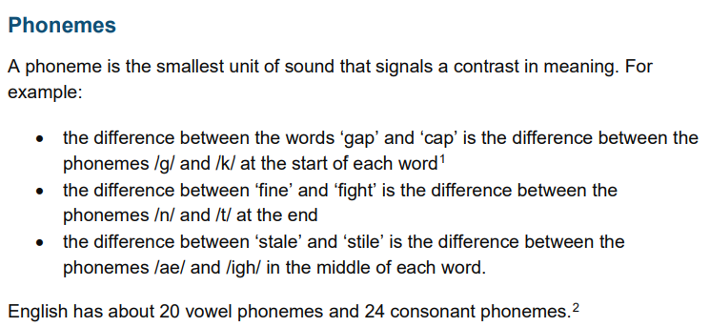

Slide 3
Articulation of phonemes
https://www.youtube-nocookie.com/embed/BqhXUW_v-1s?playlist=BqhXUW_v-1s&autoplay=1&iv_load_policy=3&loop=1&modestbranding=1&start=

Slide 4
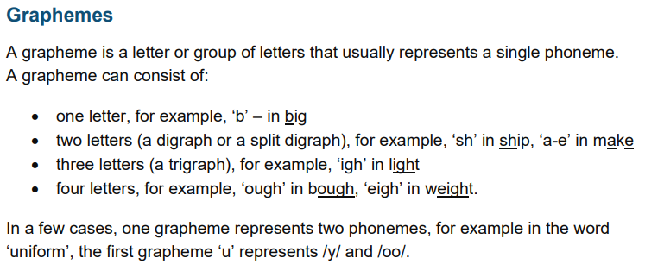

Slide 5
Vocabulary
What is a Digraph?
A digraph is two letters combined to make a single sound in written or spoken English. A digraph can consist of consonants and vowels. These shouldn't be confused with adjacent consonants, where each letter makes a distinct sound rather than combining to make one sound

Slide 6
Trigraph
A trigraph is a single sound that is made with three letters such as igh, ore, air, ear and so on. Whereas, a digraph is a single sound which has been formed by two letters.

Slide 7
Blending and segmenting
https://www.youtube-nocookie.com/embed/T2CNZoOshew?playlist=T2CNZoOshew&autoplay=1&iv_load_policy=3&loop=1&modestbranding=1&start=
https://www.youtube-nocookie.com/embed/2XTk_xf6wbo?playlist=2XTk_xf6wbo&autoplay=1&iv_load_policy=3&loop=1&modestbranding=1&start=

