Slide 1

“We know that happy, well settled children learn better and have higher wellbeing.
We know that children need support to adjust and move from place to place, person to person”.
The British Association for Childhood Education
Reception Information Meeting

Slide 2
Maple Tree Primary School
Reception Information Meeting
Mrs Victoria Darnell
Early Years Leader
Fir (Reception) Class Teacher

Slide 3


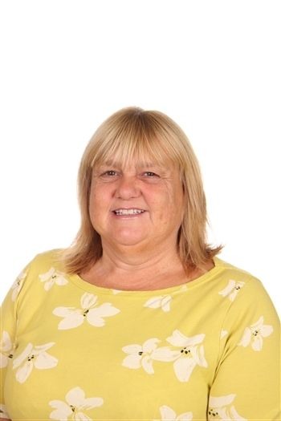
Staffing in Reception
Mrs Darnell Fir Class Teacher Early Years Leader | Mrs Hilditch Teaching Assistant | Mrs Hampton Teaching Assistant
Reception Information Meeting

Slide 4

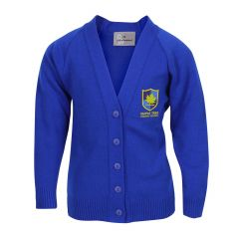
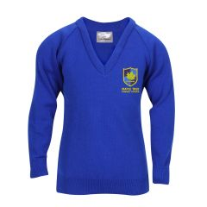
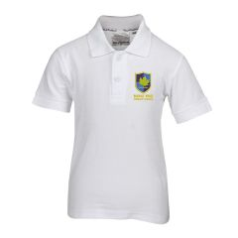
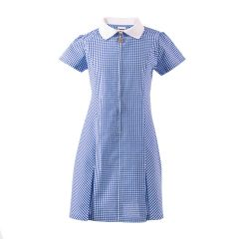
Uniform
ALL CLEARLY NAMED PLEASE
Royal blue knitted jumper or cardigan,
White polo shirt,
Navy trousers or skirt/pinafore
Yellow or blue checked dress for summer (optional)
Reception Information Meeting
Notes:
Shoes – Velcro is our friend

Slide 5
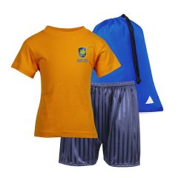
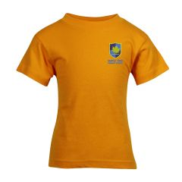
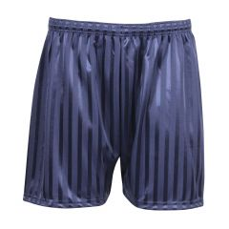
PE Kit
ALL CLEARLY NAMED PLEASE
Yellow t-shirt
Navy shorts
Trainers
Reception Information Meeting

Slide 6
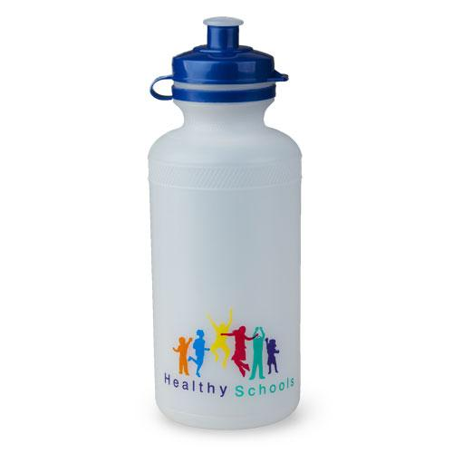

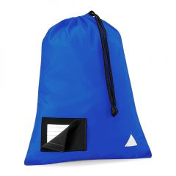
Equipment
All children need:
  A Book Bag
  A water bottle
  Spare Clothes (just in case, ideally a
draw string bag)
  Clothing appropriate to the weather
  e.g. wellies, sunhat, coat
ALL CLEARLY NAMED PLEASE
Reception Information Meeting
Notes:
Show boxes and bags

Slide 7
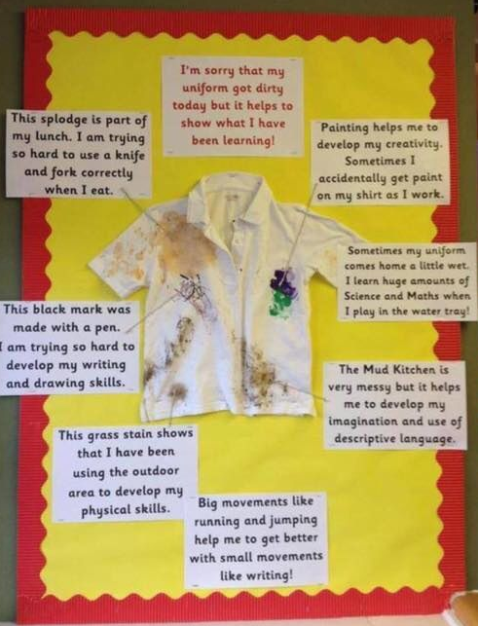
Will my child’s school uniform get dirty?
Notes:
Yes ……but…..
Outdoor coat – we go outside lots
Wellies

Slide 8


School Meals and Snacks
School Meals are provided by HCL and can be ordered at home using the School Grid App (leaflet in pack – please activate your account).
Children may bring a packed lunch.
No Nuts
Daily snack – fruit/veg provided through government scheme.
Children may choose milk (free) or water at snack time.
Please provide a named water bottle each day (water only please) – children will have access to fresh water throughout the day
Reception Information Meeting
Notes:
School dinners are provided by HCL.
All children from Reception to Year 2 are provided with Free School Meals
School lunches are ordered online from home using the online app (can be done at school if you forget).
Packed lunches should be healthy. It is school policy that no nuts, fizzy drinks, sweets or chocolate are to be included in a packed lunch – thank you.
Through the free fruit and veg scheme for schools we provide a healthy snack for the children in the Foundation Stage and Key Stage 1.
Children in the Foundation stage may choose to have a drink of milk or water.

Slide 9
Free School Meals / Pupil Premium
If you receive certain benefits or have a low household income it is likely that your child is eligible for Free School Meals / Pupil Premium.
All children in Reception receive Universal Free School Meals, however Pupil Premium funding pays for extra support in school, pupil wellbeing worker, resources and help with school visits and uniform costs.
Please see leaflet for information on how to apply.
Further information on school website.
Reception Information Meeting

Slide 10

School Houses
Your child will be allocated to one of our houses. If you already have a child at Maple Tree, siblings will be put into the same house.
Reception Information Meeting
Notes:
I use houses to group the children – they get to know their house very well

Slide 11

Getting ready for school
Your first information pack had a leaflet from Central Bedfordshire with ‘16 ticks’ – things it would be great for your child to have achieved before coming to school.
Please remember every child develops at their own pace and some children will be just 4 when they move to Reception, while others will be nearly 5.
Don’t worry!
Reception Information Meeting
Notes:
TOILET – unless a medical need and an intimate care plan we cannot clean your child – we will of course support and help but usually through directions, holding the bag open etc
SHOES
CUTLERY
COATS

Slide 12

The Early Years Curriculum
The first year of formal school is part of the EYFS (covers birth to 5)
Themes underpinning the curriculum experience are:
Reception Information Meeting

Slide 13
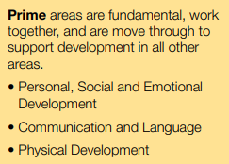
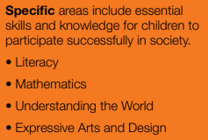
The Early Years Curriculum
Reception Information Meeting
Notes:
The prime areas begin to develop quickly in response to relationships and experiences, and run through and support learning in all other areas. The prime areas continue to be fundamental throughout the EYFS.
The specific areas include essential skills and knowledge. They grow out of the prime areas, and provide important contexts for learning.
Further info throughout the year – eg phonics and reading

Slide 14

WOWs!
Reception Information Meeting
Notes:
Partnership between home and school.
Cut off and send in
Achievements/experiences at home – celebrated at school – eg sharing with a sibling, getting dressed indep
I give out more sheets

Slide 15
What if my child needs extra support?
Every child is unique!
All children need adult support and some will need extra opportunities for this in small groups or 1:1
If you are concerned about your child’s learning or development talk to us
We will talk to you if we have concerns and can seek additional help within and outside of school if needed
Reception Information Meeting
Notes:
SENDCO
EAL
Can by any area e.g. speech, behaviour, physical, learning

Slide 16
How do we get to know your child?
Activities to help us to get to know each other:
  Letter from Mrs Darnell to each child
  Summer Activities
  Phased introduction to school. Part time = less children with more adult time
  Visit to meet Mrs Darnell Monday morning 7th July 9.15-10.45am.
Reception Information Meeting

Slide 17

Marvellous Me
School to home communication app
  Individual messages from teacher to parent
  Awards/rewards celebrating success
  Teacher can share photos and activities
Please sign up for Marvellous Me! – consider and respond to photo permissions.
Reception Information Meeting
Notes:
JUST FOR OUR CLASS – NOT FOR SOCIAL MEDIA

Slide 18
Timings and Routines
8:55am doors open (before this line up at the classroom door ready). Say goodbye outside – your child will come in, put their coat, book bag and lunch etc. away and self register using their name/photo card.
During the morning all children will be offered a snack and milk/water.
Lunch: 11:45 – children will eat a school meal or packed lunch in the hall. Staff will help them – it’s useful if you practice using cutlery at home. They will play afterwards in the Early Years playground.
3:30pm School ends – children to be collected from the classroom door.
Reception Information Meeting
Notes:
Practice coats on and off and fastening and unfastening etc.
When collecting stand back so we can see you – it will take while to match the right child to the right adult.
Which door
Please inform the school office if your child will be picked up by someone else. We will not let them go with anyone else unless we have your permission and you have informed a member of reception staff directly or spoken to the school office.

Slide 19

Wrap around care
Kids Club operates from the school in a room near to our classroom. This means that you can drop your child off at Breakfast Club and they will be taken straight to lessons from there.
Breakfast Club: Monday - Friday Term Time, 7.30 – 8.55am
After School Kid's Club: Monday - Thursday Term Time, 3.30 – 4.30 / 6.00pm
Further information on kids club and holiday club can be found on our school website under ‘The Community’ tab.
Reception Information Meeting

Slide 20
Information Pack
School Grid Information (School Meals)
‘Marvellous Me’ login details and information
Free School Meals (Pupil Premium) leaflet
A letter for your child
Information Leaflet
September group, dates and timings for your child
CBC term dates
Summer Activities information
Reception Information Meeting
Notes:
Please apply for Free School Meals if you think you may be eligible – there are additional benefits to this and the school receives additional funding.
When you check your pack, please confirm the correct spelling of names and let us know your child’s preferred name

Slide 21
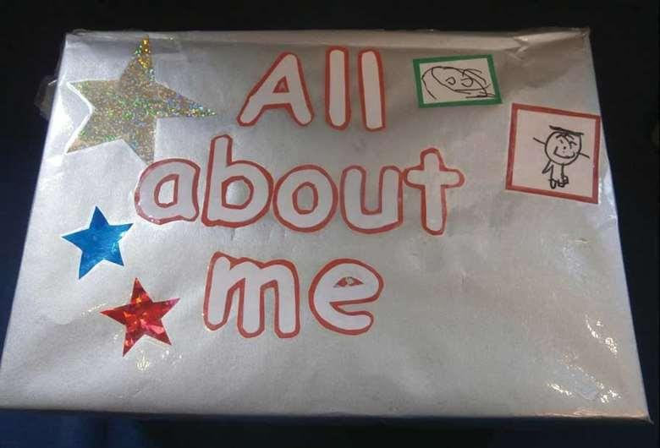
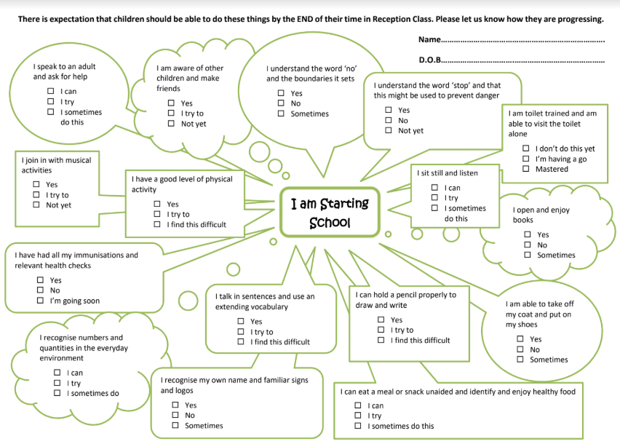
Summer Activities
Reception Information Meeting

Slide 22
September Starting School Dates & Times
Mon 1st/Tues 2nd Septmeber | Training Days
Wednesday 3rd September | Fir Group A | 8.55am to 11.45am collection from rear door
 | Fir Group B | 12.45pm to 3.30pm drop off at rear door
Thursday 4th September | Fir Group B | 8.55am to 11.45am collection from rear door
 | Fir Group A | 12.45pm to 3.30pm drop off at rear door
Friday 5th September | All Fir Class | All Fir Class 8.55am to 11.45am collection from rear door
Monday 8th September | All Fir Class | All Fir Class 8.55am to 1pm (includes lunchtime) collection from rear door
From Tuesday 9th September all children will be in for full days – 8.55am-3:30pm.
Reception Information Meeting
Notes:
Door
Book dinners/ bring pack lunch from the Wednesday
Groups – split in half alphabetically
Helps to build – stamina, relationships with staff and each other

Slide 23

Communication
Communication between home and school is vital for your child’s success
There are many opportunities for communication (formal and informal)
PLEASE TALK TO ME!
Reception Information Meeting
Notes:
Daily before/after school or office if at work
If you want to be confidential ask for a private chat or let the office know you would like me to give you a ring
Parents evenings Autumn and Spring Term
Annual end of year report – EYFS Profile
School weekly newsletter
ParentMail
Marvellous Me

