Slide 1
Multiplication Tables Check
Parent/Carers Information

Slide 2
Contents
Section 1: National Curriculum Expectations, and the purpose of the MTC.
Section 2: What happens during the MTC?
Section 3: Why are times tables so important?
Section 4: How can you help at home?
Section 5: Any questions?

Slide 3
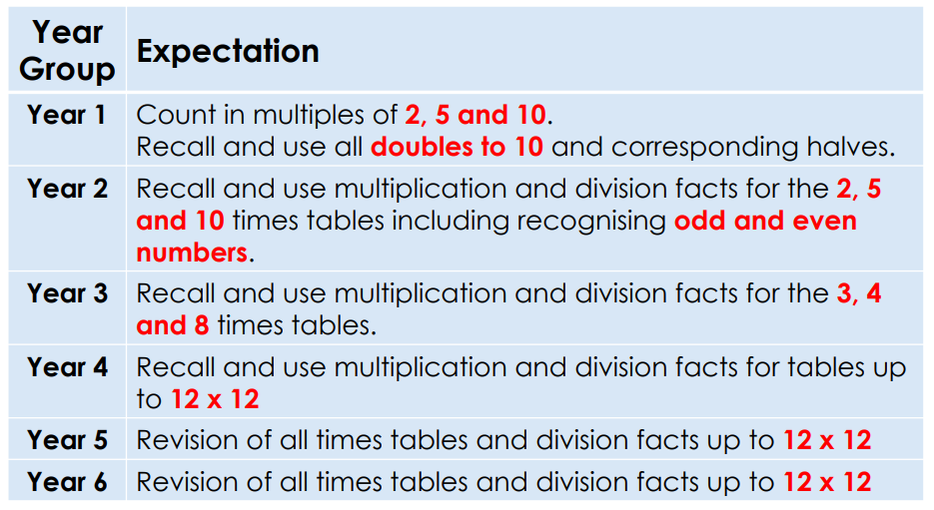
National Curriculum Expectations

Slide 4

The purpose of the MTC

Slide 5
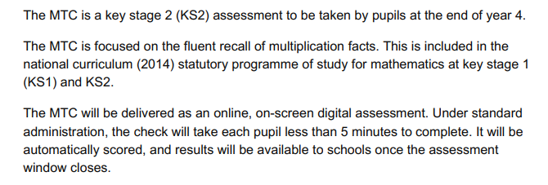
About the MTC

Slide 6
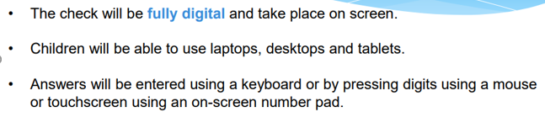
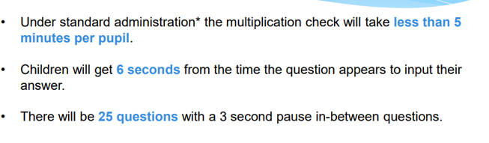
How the multiplication tables check is carried out

Slide 7
Access Arrangements
Any adjustments to the check will be discussed, and shared, with individual children and their parents/carers.
Although not part of access arrangements, some children may do the check individually, with adult supervision, or in small groups.

Slide 8
When will the MTC take place?
There will be a 3 week window to administer the MTC in June.
There is no set day to administer the MTC.

Slide 9
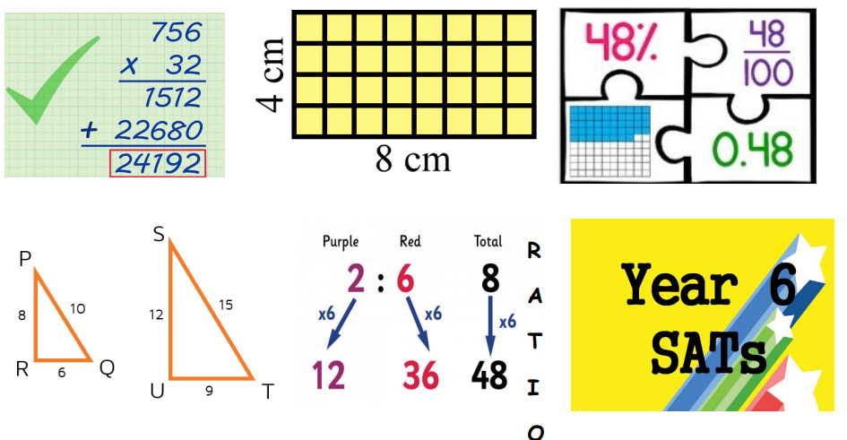
Why is it important to know your times tables?
There is a variety of other areas within maths where we need to use times tables.
For example:
area, fractions, decimals, percentages, scaling, and ratio.

Slide 10
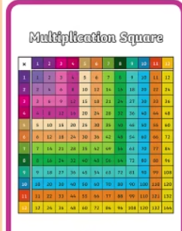
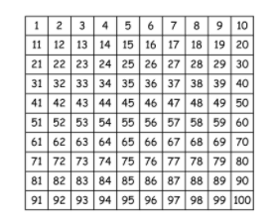
How we teach multiplication facts:
We encourage children to look for patterns.
We look for ways to check answers – digit sums, what does the product end in,
is the product odd or even?
We sing out ‘rolling numbers’.
We play interactive games.

Slide 11
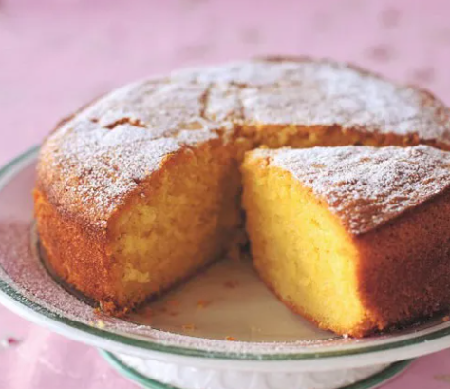

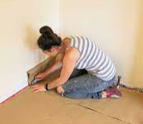
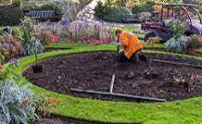
What about in the real world?
Many occupations use times tables on a daily basis.

Slide 12


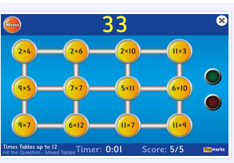

How can you help at home?
Each child has a login. We set battles against classes. Raffle tickets are won, and winners entered into a prize draw.
https://mathsframe.co.uk/en/resources/resource/477/Multiplication-Tables-Check
https://www.topmarks.co.uk/maths-games/7-11-years/multiplication-and-division
https://www.youtube.com/watch?v=cuvxmjgkjU0&t=150s

