Slide 1

Key Stage 1
Parents and Carers Information

Slide 2
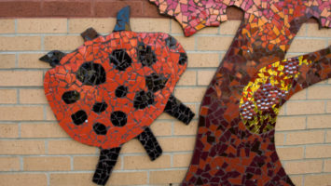
Content
Timetable and structure of KS1 day
Break times and snack
Curriculum
Stand alone subjects
Reading and Accelerated Reading
Phonics
Handwriting
Maths
Special person and homework
Behaviour and rewards
House keeping
Uniform
Class DoJo
Pupil Premium

Slide 3
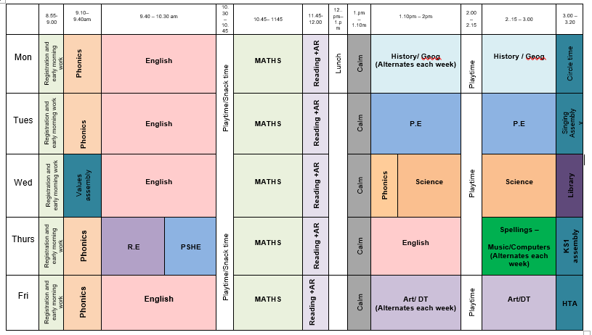
Sample Timetable and Structure of KS1 – Two week rotating timetable
Mornings
Core subjects
Afternoons
Foundation subjects

Slide 4

Curriculum –
Across the year the children are taught
English
Maths
Science
History
Geography
Art
D and T
Computing
R.E
P.E
Music
Phonics
Handwriting

Slide 5
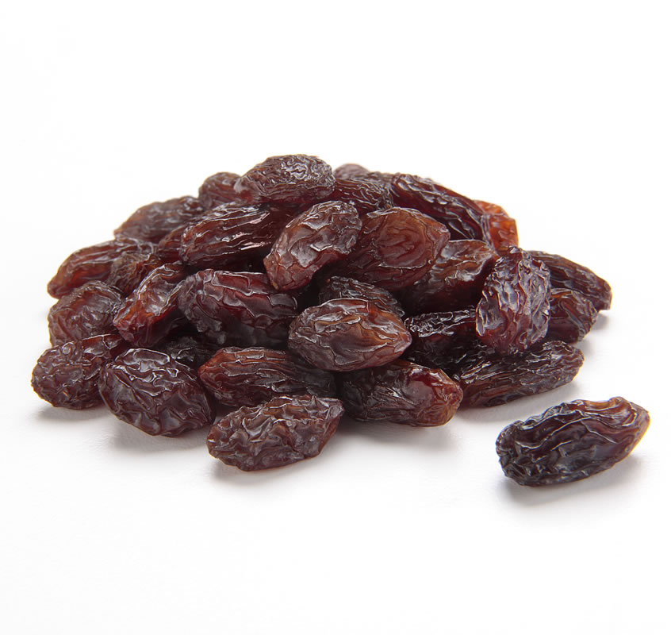




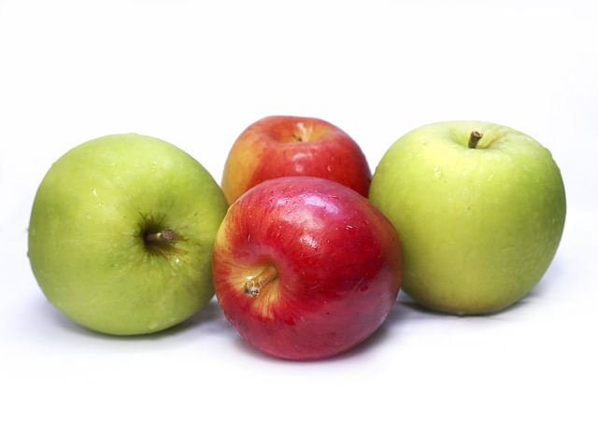


Break Times and Snack
Morning Break 10:30-10.45
Healthy snack provided by school or own can be brought in – fruit or vegetables. No Nuts.
Milk - Pre-paid, PP
Lunch 12:00 – 1:00pm
Afternoon Break 2:00 – 2.15
Named water bottles. Water Only

Slide 6
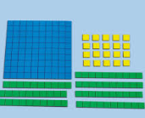
Maths
How you can help at home -
  Number and place value – counting, forming, recognising and representing, addition, subtraction, multiplication, division and fractions
  Shape – 2D and 3D – including properties
  Money – recognising different denominations – working out money problems
  Time – o’clock, half past, quarter past, analogue, days of the week and months of the year
  Measurement – capacity, length and weight
  Position and movement – directions, turns

Slide 7
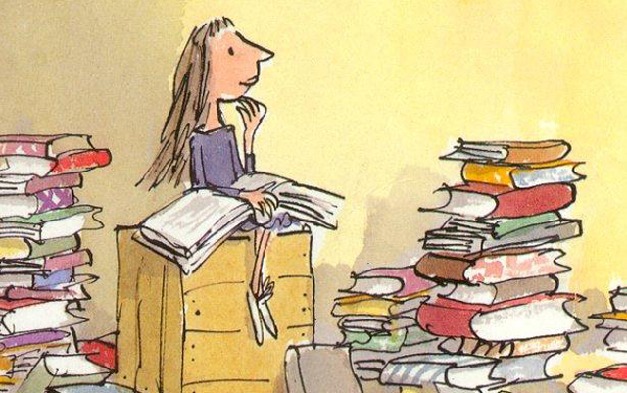
Reading Books and Accelerated Reader
Year 1 diaries are checked and books swapped once the book has been read three times with an adult.
Year 2 also swap books after being read three times. This will change if they move to the AR system.
Encourage your child to read at home daily – make it fun!
Comprehension – ask your child questions!
Accelerated Reader – During Year 2 children can progress to the accelerated reading programme when ready

Slide 8
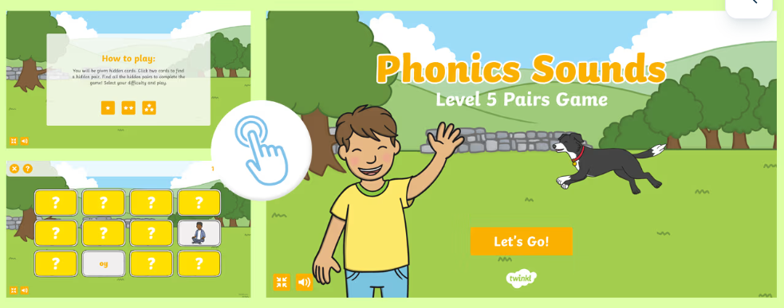

Phonics
Focus on phase 3, 4 and 5
Phonics screening check year 1 and year 2

Slide 9
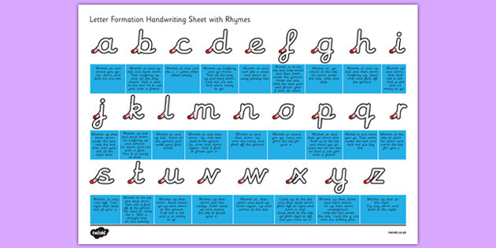

Handwriting
Cursive – children are taught to write with pre-cursive handwriting ready to join their letters together
Lead ins and lead outs
Encourage to do this outside of school
Form letters and numbers correctly
Handout available for letter formation if needed

Slide 10


Special Person
Special Person is weekly – dates in the front of reading diary
Children are to bring in certificates, pictures etc……
Spellings Year 1 to start after half term
Reading Books
Practise NumBots

Slide 11


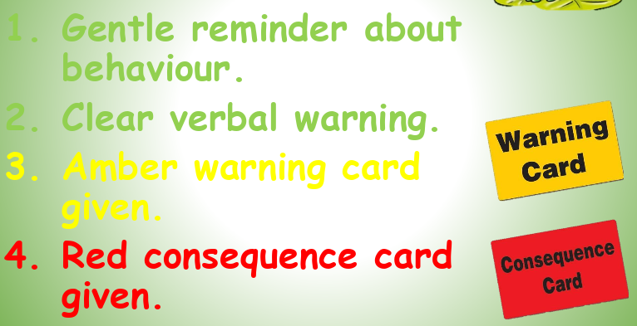
Behaviour and Rewards
We are:
Ready
Respectful
Safe
House Points

Slide 12

Class DoJo
We’re thrilled to be using Class DoJo to tell you about the wonderful things your child is doing, and to celebrate their achievements. It’s free and you can share it with partners, carers and grandparents.
For new parents and those still to join, please ask the office for a letter. For existing parents, please remember to check you have the latest Class DoJo parent app installed and are logged in. You don’t want to miss out!
What to expect? Teachers will be:
· Sharing a learning comment (activity) with all parents at least two times a week, such as a summary of what they have been learning about. This is a one way communication tool so the chat function is not in place. Please contact the teacher email should you need to ask anything.
Teachers may:
· Send out message reminders for things like PE kits or letters coming home.
· Send out points for children in different classes.

Slide 13
Uniform at Maple Tree Primary School
All the children are expected to wear black trousers, shorts or skirts with a royal blue knitted jumper or cardigan.
In Mulberries only, we also accept navy joggers or leggings.
From Reception to Year 2 the children wear white polo shirts under their jumpers.
Across the school, yellow or blue checked summer dresses are allowed in the warm weather.
All children should be wearing smart black school shoes: no heels, trainers or strappy sandals allowed. Velcro fastenings are much appreciated in the younger years where pupils can’t yet tie their own laces.
Our PE kit consists of: a yellow t-shirt, navy shorts, plain navy/black jumper and joggers and trainers for outdoor activities. Children should come to school in their PE kit on the day that they have PE or a PE club, as this maximises the learning time and decreases the amount of lost uniform. Earrings ideally should not be worn, however tape can be applied to cover them for the lesson. No hoops.

Slide 14

Housekeeping - How you can help?
All belongings to be named including bottles
Reading books in school everyday
PE – outdoors – wear weather appropriate clothing, tape for pierced ears and hair tied back
At times the children may become wet with
outdoor activities and so a change of socks, bottoms,
and underwear are useful

Slide 15

Pupil Premium
What is it?
Pupil premium is an amount of funding that is given to the school to best support and improve attainment for low income families
Is it the same as Universal Free School Meals?
No, Universal Free School meals is a government initiative in which children in EYFS and KS1 can receive free provided meals. From year 3 lunches are paid for by parents and guardians.
How does this help?
PP funding can help with uniforms, school trips, lunches, resources in the classroom to aid learning
What do I need to know?
See the following slide if you feel your child is entitled to PP funding.

Slide 16
Pupil Premium
Contact – Central Beds Pupil Premium Meals Hotline 0300 300 8306
The qualifying benefits to receive Pupil Premium Funding for all children (and free school meals in years Three and Four) are:
Income Support
Income-based Jobseeker’s Allowance
Income-related Employment and Support Allowance
Support under Part IV of the Immigration and Asylum Act 1999
The Guarantee element of State Pension Credit
Child Tax Credit (provided you are not also entitled to Working Tax Credit, and your annual gross income does not exceed £16,190 as assessed by His Majesty's Revenue and Customs)
Working Tax Credit run-on (paid for 4 weeks after you stop qualifying for Working Tax Credit)
Universal Credit (during the initial roll-out of this benefit)

